Slide 1
Views of data and records

Slide 2
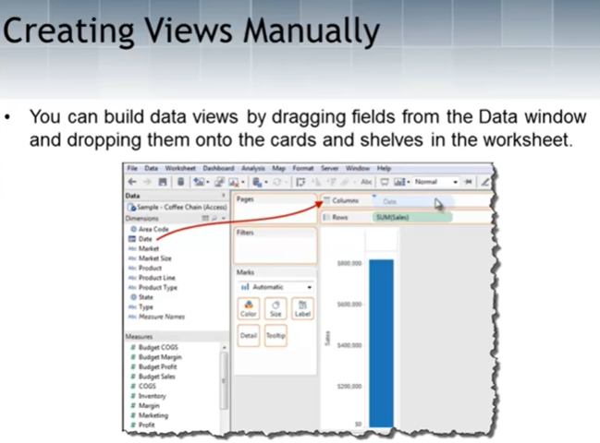

Views

Slide 3
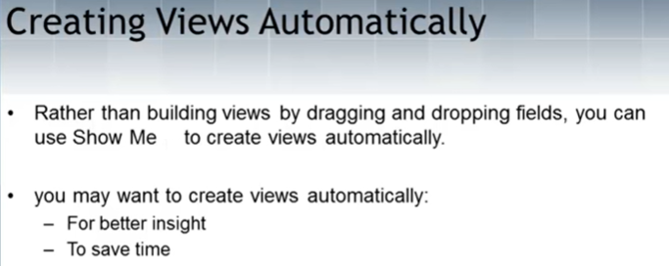

Views

Slide 4
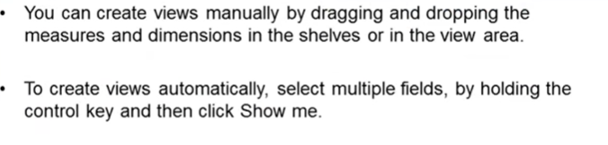
Views – Manual / Automatic

